Slide 1

Solving Travelling Salesman Problem using Ant Colony Optimization
BILEL HAMZA
MOHAMED KHALIL HAMMOUDI

Slide 2
AGENDA
ACO Explained
Initial Solution
Playing with the parameters
Key findings and discussion
Optimization

Slide 3
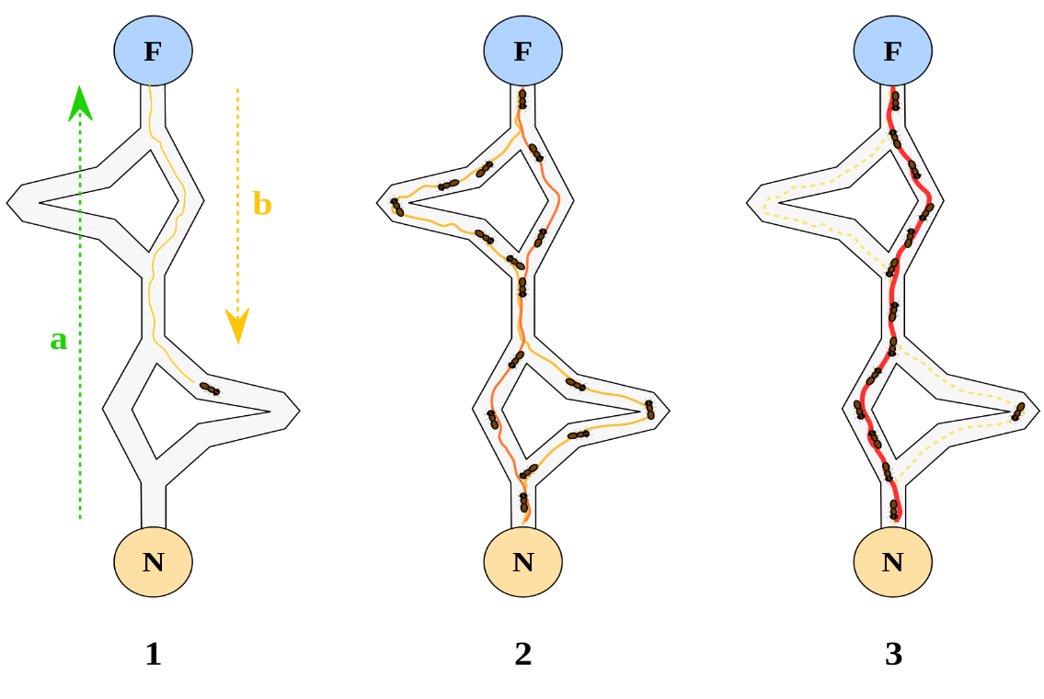
ACO Explained
ACO Parameters:
Number of iterations (Iterations),
Heuristic Information α (alpha): It represents the importance of heuristic information in the ant's decision-making process,
Heuristic Information β (beta): It determines the importance of pheromone trails in the ant's decision-making,
Pheromone Evaporation Rate (rho): It determines the pheromone’s evaporation rate

Slide 4
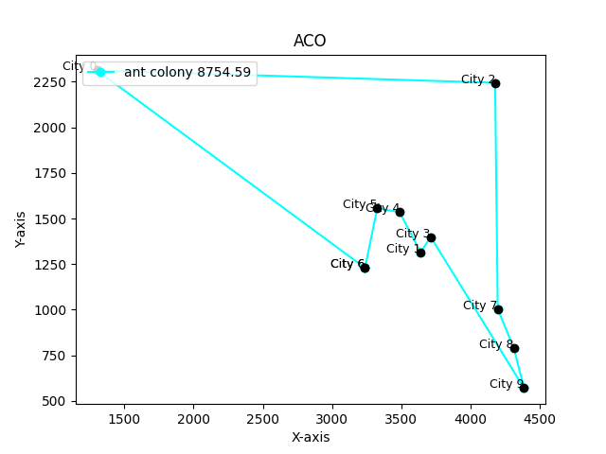
EXAMPLE
Number of city = 10
Best path from ant colony optimization:
[6, 5, 4, 1, 3, 9, 8, 7, 2, 0, 6]
shortest distance = 8754.59
CPU time = 0,21462 s

Slide 5
INITIAL SOLUTION
NUMBER_OF_ITERATIONS = 100 ; EVAPORATION_FACTOR = 0.5 ; UPDATED_PHEROMONE_VALUE = 7 ; ALPHA = 1 ; BETA = 1
Instances |  | Reference Solution | CPU Time in seconds
Designation | Number of cities
TSP1 | 5 | 6 534,52180 | 0,14733
TSP2 | 10 | 8 736,39870 | 0,20286
TSP3 | 15 | 10 608,80240 | 0,68177
TSP4 | 20 | 11 685,29450 | 0,55765
TSP5 | 25 | 13 787,49410 | 1,09299
TSP6 | 30 | 15 887,78670 | 1,53025
TSP7 | 35 | 23 517,34330 | 2,30929
TSP8 | 40 | 24 525,83456 | 4,73267
TSP9 | 70 | 25 595,63400 | 18,78000
TSP10 | 130 | 36 209,67190 | 127,99490
TSP11 | 200 | 47 832,46425 | 498,92340
AVERAGE |  |  | 59,72301

Slide 6
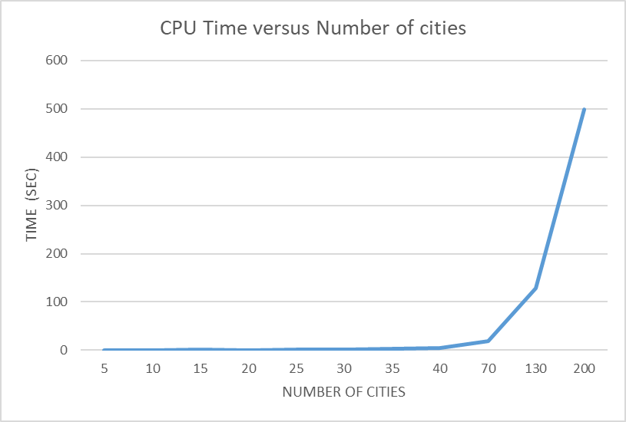
VARYING THE NUMBER OF CITIES

Slide 7
PLAYING WITH NUMBER OF ITERATIONS
NUMBER OF ITERATIONS | AVG GAP % | CPU TIME(SEC)
70 | 0,852 | 51,939
50 | 1,853 | 26,988
130 | -0,168 | 81,664
150 | 0,107 | 83,374

Slide 8
PLAYING WITH THE EVAPORATION FACTOR
EVAPORATION FACTOR | AVG GAP % | CPU TIME(SEC)
0,6 | -0,00269 | 60,56730
0,8 | 0,63481 | 60,20670
0,4 | 0,46426 | 60,02182
0,2 | 0,47993 | 60,37096

Slide 9
PLAYING WITH THE PHEROMONE VALUE
UPDATED PHEROMONE VALUE | AVG GAP % | CPU TIME(SEC)
8 | -0,31037 | 100,88348
9 | 0,76075 | 49,36380
6 | -0,15968 | 85,51669
5 | -0,01435 | 80,04646
4 | -0,05612 | 54,13483

Slide 10
Key findings and discussion
Best parameters:
NUMBER_OF_ITERATIONS = 100 EVAPORATION_FACTOR = 0.6 UPDATED_PHEROMONE_VALUE = 6 ALPHA = 1 BETA = 1

Slide 11
Optimization
The Elitist Ants:
Elitist Factor:The best path found in each iteration is given an added pheromone. This is done with the ELITIST_FACTOR within the update_pheromone_and_find_best_path function.
Local Search: A simple 2-opt local search algorithm is implemented within the local_search function. It attempts to improve the best trail by reversing segments of the path.
Total Distance Calculation: This function is defined to calculate the total distance of a given trail, making it convenient to update the pheromones based on the trail lengths.

Slide 12
Optimization
Instances |  | Reference Solution | Solution ACO | GAP% | CPU Time in seconds
Designation | Number of cities
TSP1 | 5 | 6 534,52180 | 6 066,28230 | -7,16563 | 0,02130
TSP2 | 10 | 8 736,39870 | 8 667,50772 | -0,78855 | 0,05303
TSP3 | 15 | 10 608,80240 | 10 671,41735 | 0,59022 | 0,13580
TSP4 | 20 | 11 685,29450 | 13 122,22470 | 12,29691 | 0,27128
TSP5 | 25 | 13 787,49410 | 17 887,32662 | 29,73588 | 0,69938
TSP6 | 30 | 15 887,78670 | 19 534,16620 | 22,95083 | 1,08453
AVERAGE |  |  |  | 9,60328 | 0,37755
TSP7 | 35 | 23 517,34330 | 20 520,11509 | -12,74476 | 1,28620
TSP8 | 40 | 24 525,83456 | 21 461,30733 | -12,49510 | 1.859559
TSP9 | 70 | 25 595,63400 | 25 459,65646 | -0,53125 | 85,96299
TSP10 | 100 | 34 356,62000 | 33 545,87789 | -2,35978 | 79,75878
TSP11 | 130 | 36 209,67190 | 36 960,81000 | 2,07441 | 215,88805
TSP12 | 200 | 47 832,46425 | 45 645,96074 | -4,57117 | 397,10445
TSP13 | 230 | 52 755,30291 | 51 843,09913 | -1,72912 | 750.71924
TSP14 | 300 | 63 777,27000 | 58 781,00000 | -7,83394 | 880.77066
AVERAGE |  |  |  | -5,02384 | 156,00009
Number of cities <= 30: ACO
Number of cities >30 : Elitist Ants

Slide 13
Some use of ACO in CNN
Determining the best number of layers (see MNIST code)
Initializing the initial weights
Selecting features:
See: OPTIMIZATION OF ARTIFICIAL NEURAL NETWORKS USING ANT COLONY OPTIMIZATION TO IDENTIFY SIGNATURE IMAGES
See: ANT COLONY OPTIMIZATION-ENABLED CNN DEEP LEARNING TECHNIQUE FOR ACCURATE DETECTION OF CERVICAL CANCER

Slide 14
Thanks for your attention !

